Slide 1
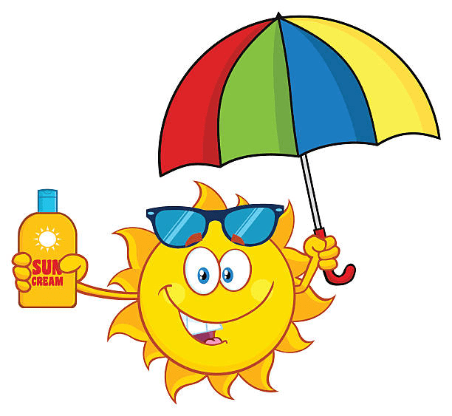
SKIN CANCER AND BEING SUN SMART
Huy dINH
Deepa NAIR
CHRISTOPHER MAI

Slide 2
Questions
1.Why does Australia need to be serious about skin cancer?
2. Who are the most impacted?
3. Is skin cancer impacting the economy?
4. Are there factors that are directly corelated and can be controlled to reduce the incidence of skin cancer? Is the factor quantifiable?
5. Is this disease preventable by changes at individual level?

Slide 3
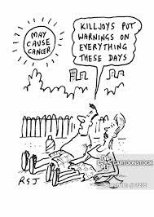
Objectives
To study the prevalence & magnitude of skin cancer in Australia
Demographics and skin cancer
A data driven study to identify all the risk factors contributing to skin cancer.
The economic burden of the disease
State wise skin cancer counts and their correlating factors.
an epidemiologic study that are essential in assessing the relationship between exposure to sun and skin cancer counts
Is this preventable??

Slide 4
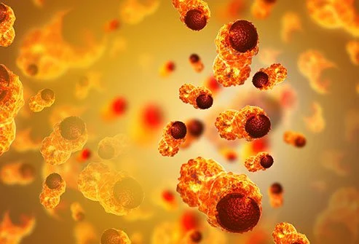
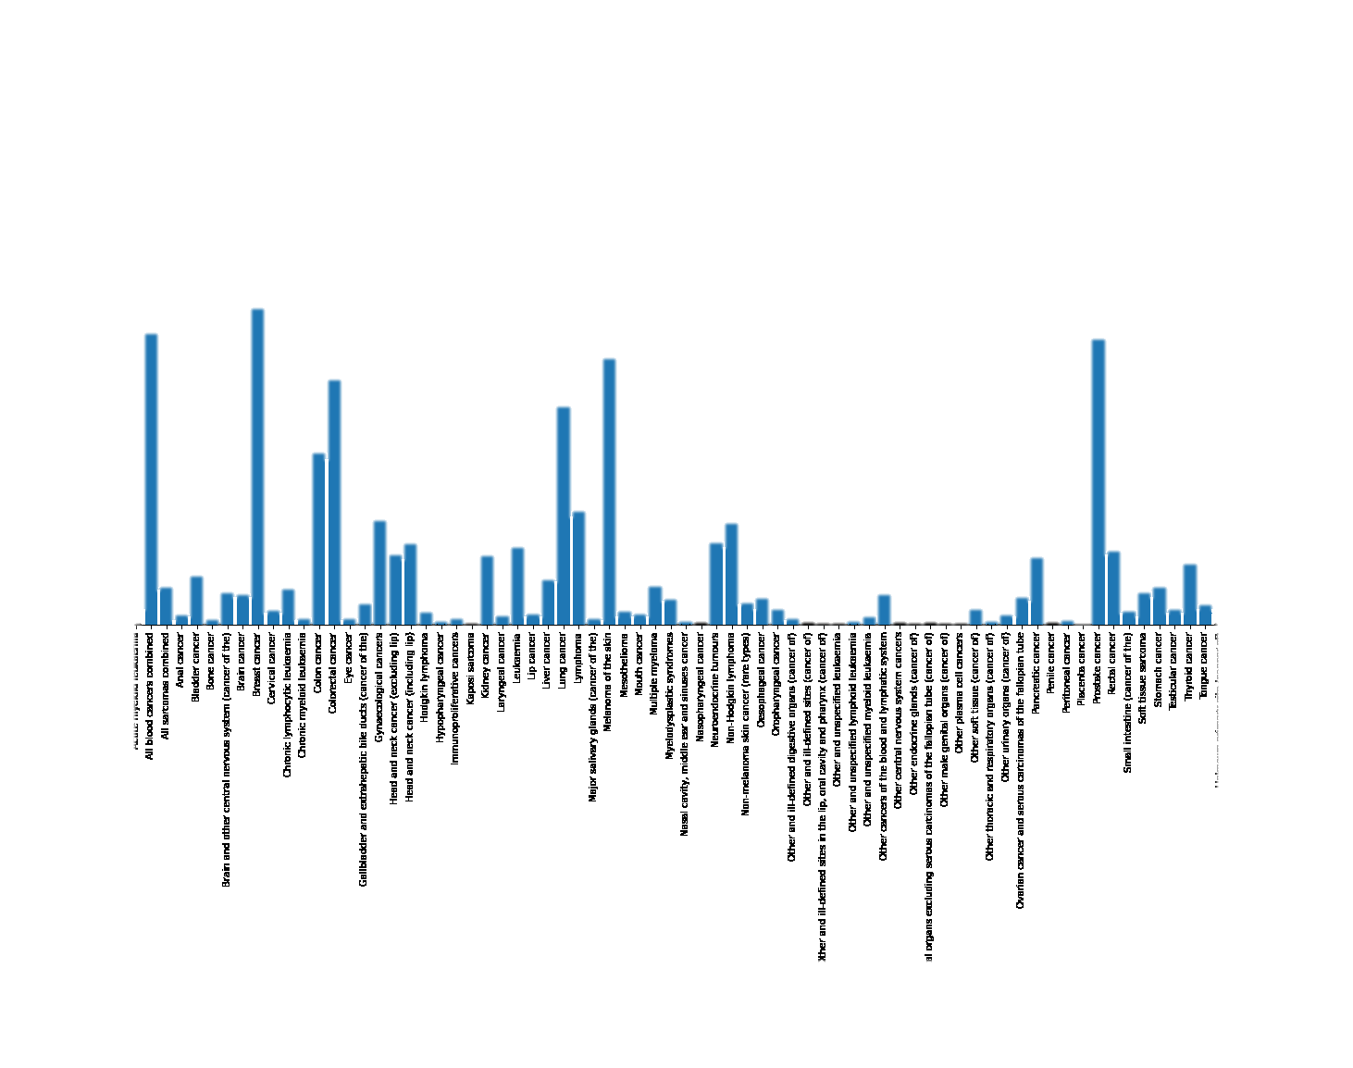
Different types of cancers in Australia
Skin cancer

Slide 5
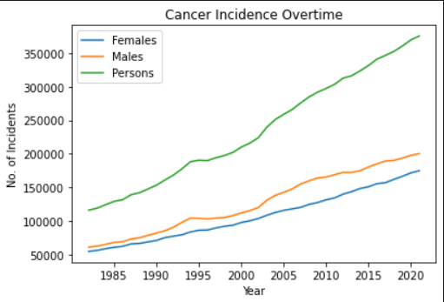
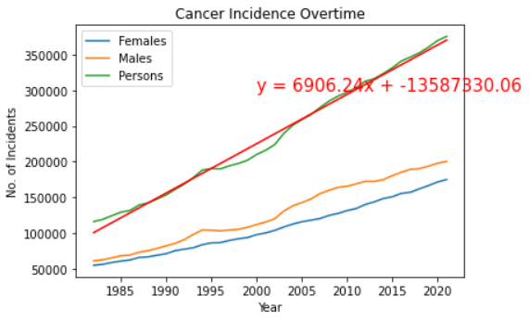
Cancer Incidence overtime
Cancer is the leading cause of death by disease in adults and children in Australia, exceeding ischaemic heart disease, dementia and cerebral vascular disease. According to Australian Institute of Health and Welfare statistics, in 2020:
•over 145,000 Australians were diagnosed with cancer and cancer accounted for nearly 50,000 deaths, and
•three in every 10 deaths was due to cancer.

Slide 6
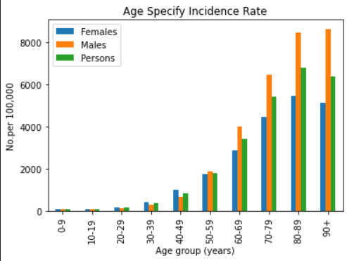
ASR Incidence vs Age group

Slide 7
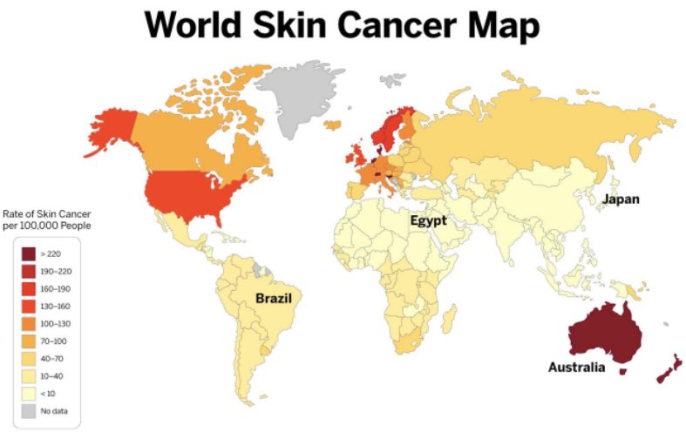
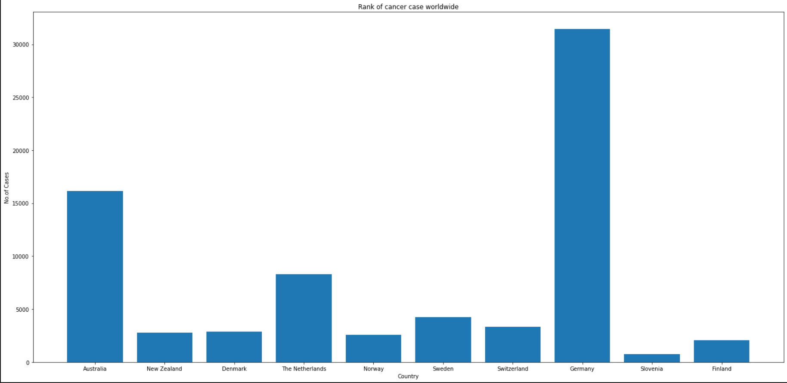
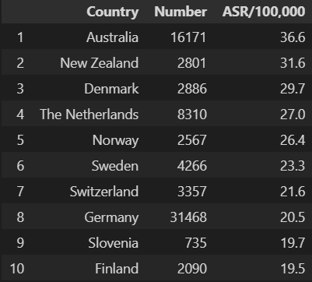
Australia vs Worldwide

Slide 8
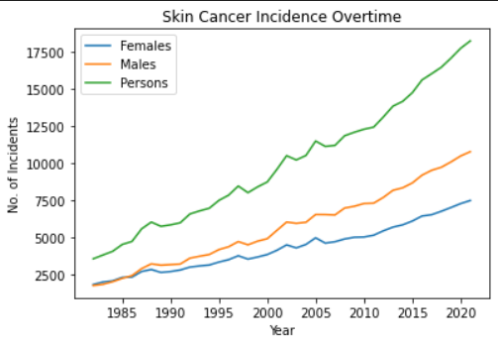
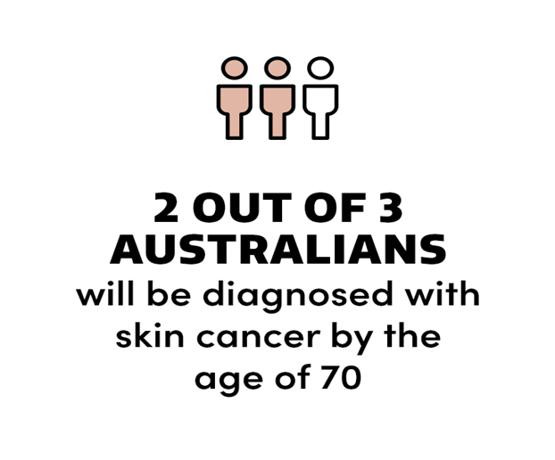
Skin Cancer Incidence overtime

Slide 9
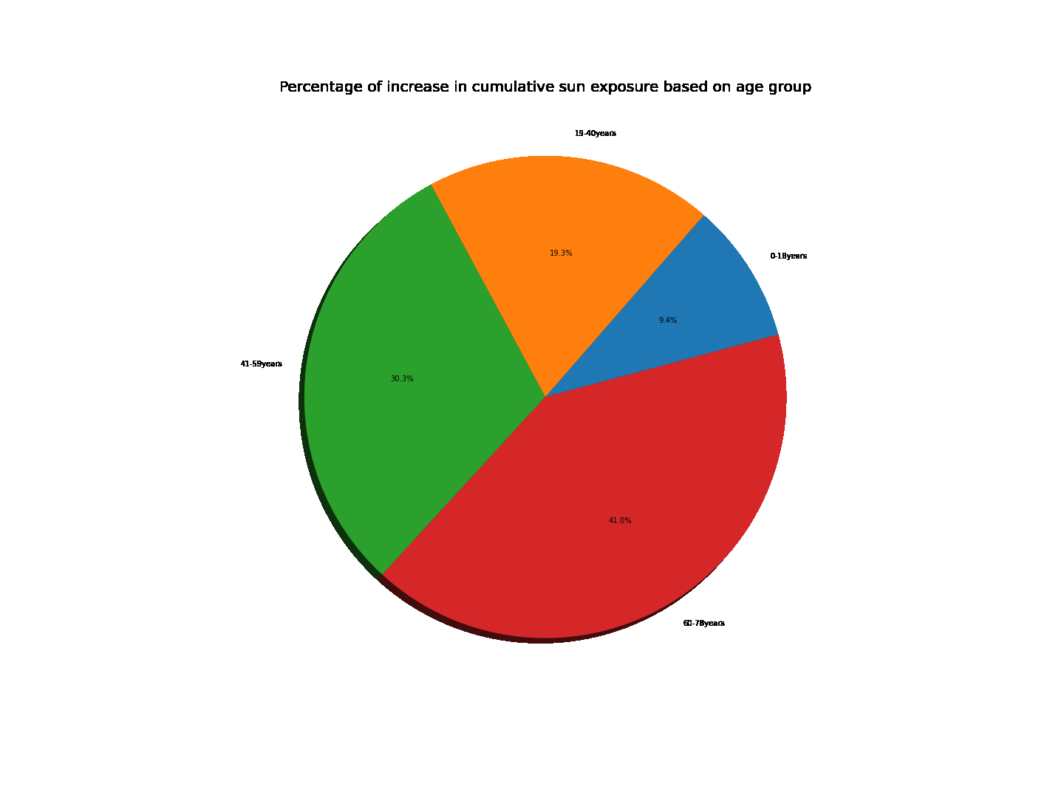
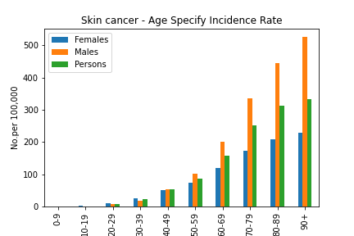
What has age to do with skin cancer????

Slide 10
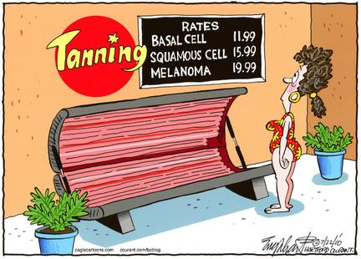
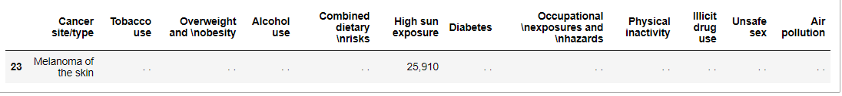
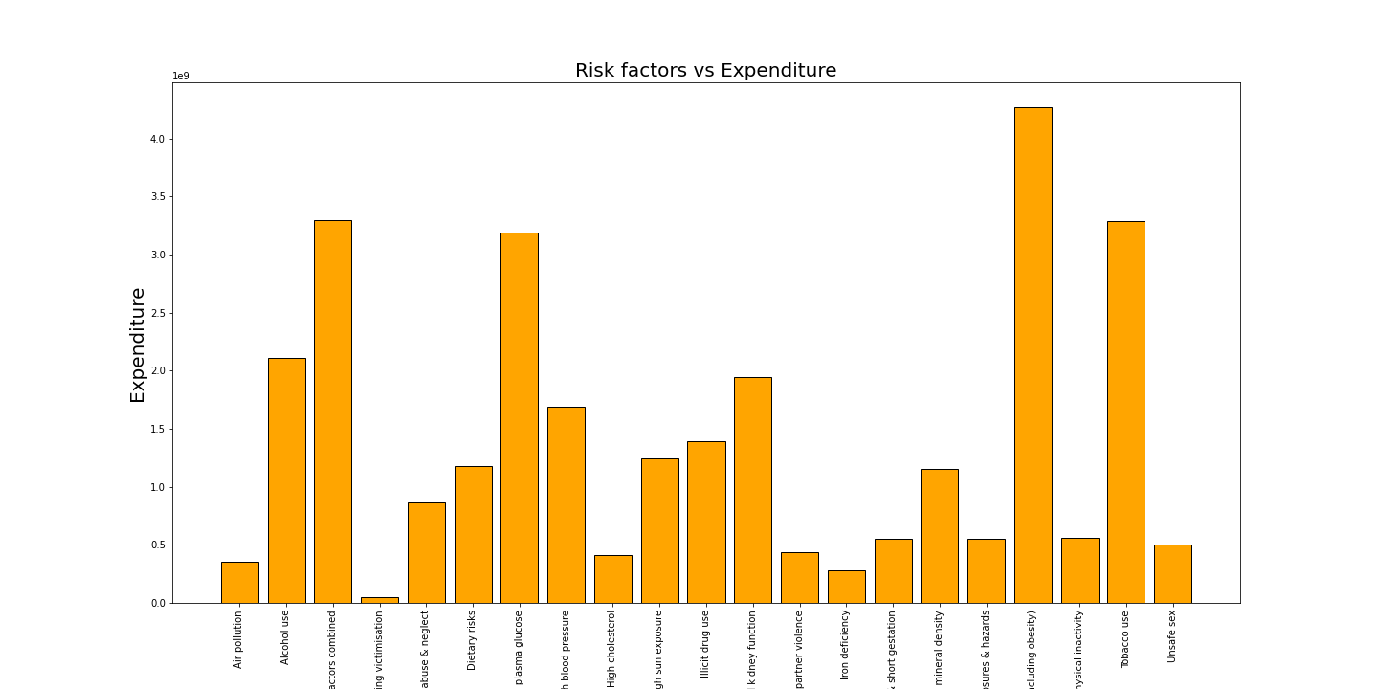

Slide 11
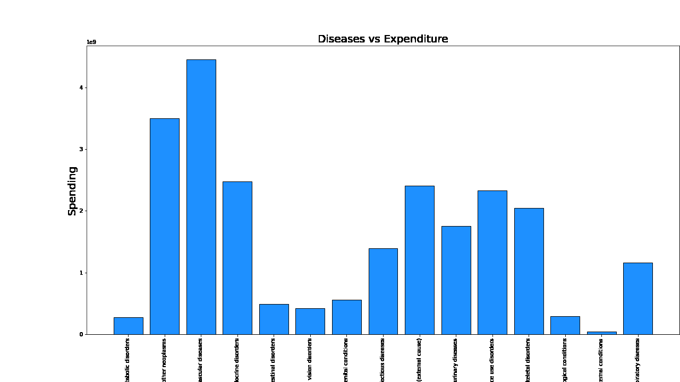
The burden of disease from cancer in Australia is forecast to grow, with one in every two Australians forecast to be diagnosed with cancer by the age of 85 years.

Slide 12
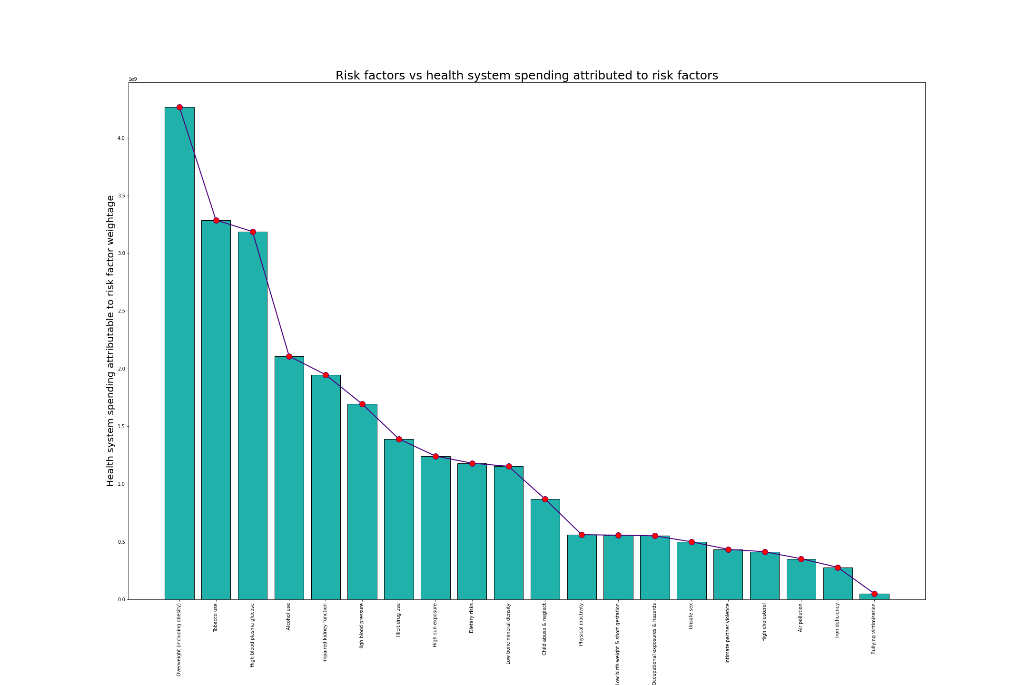


Slide 13
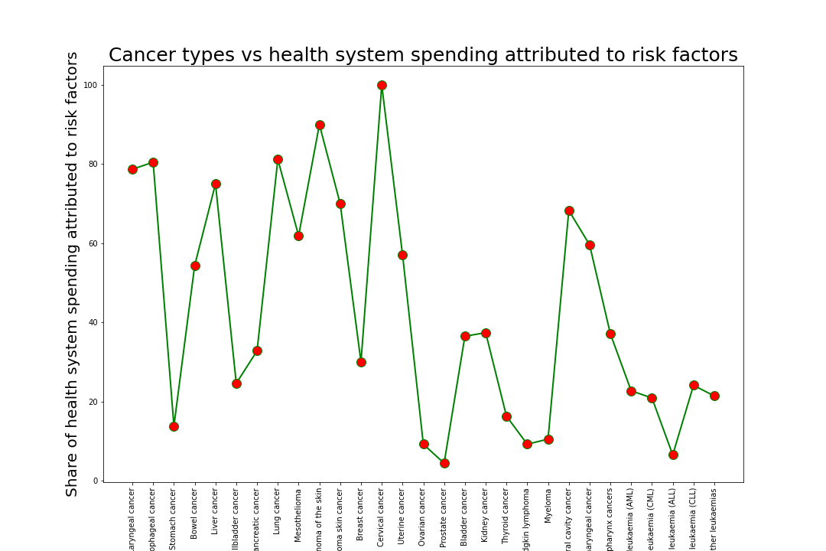
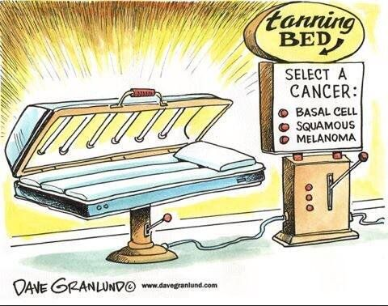

Slide 14
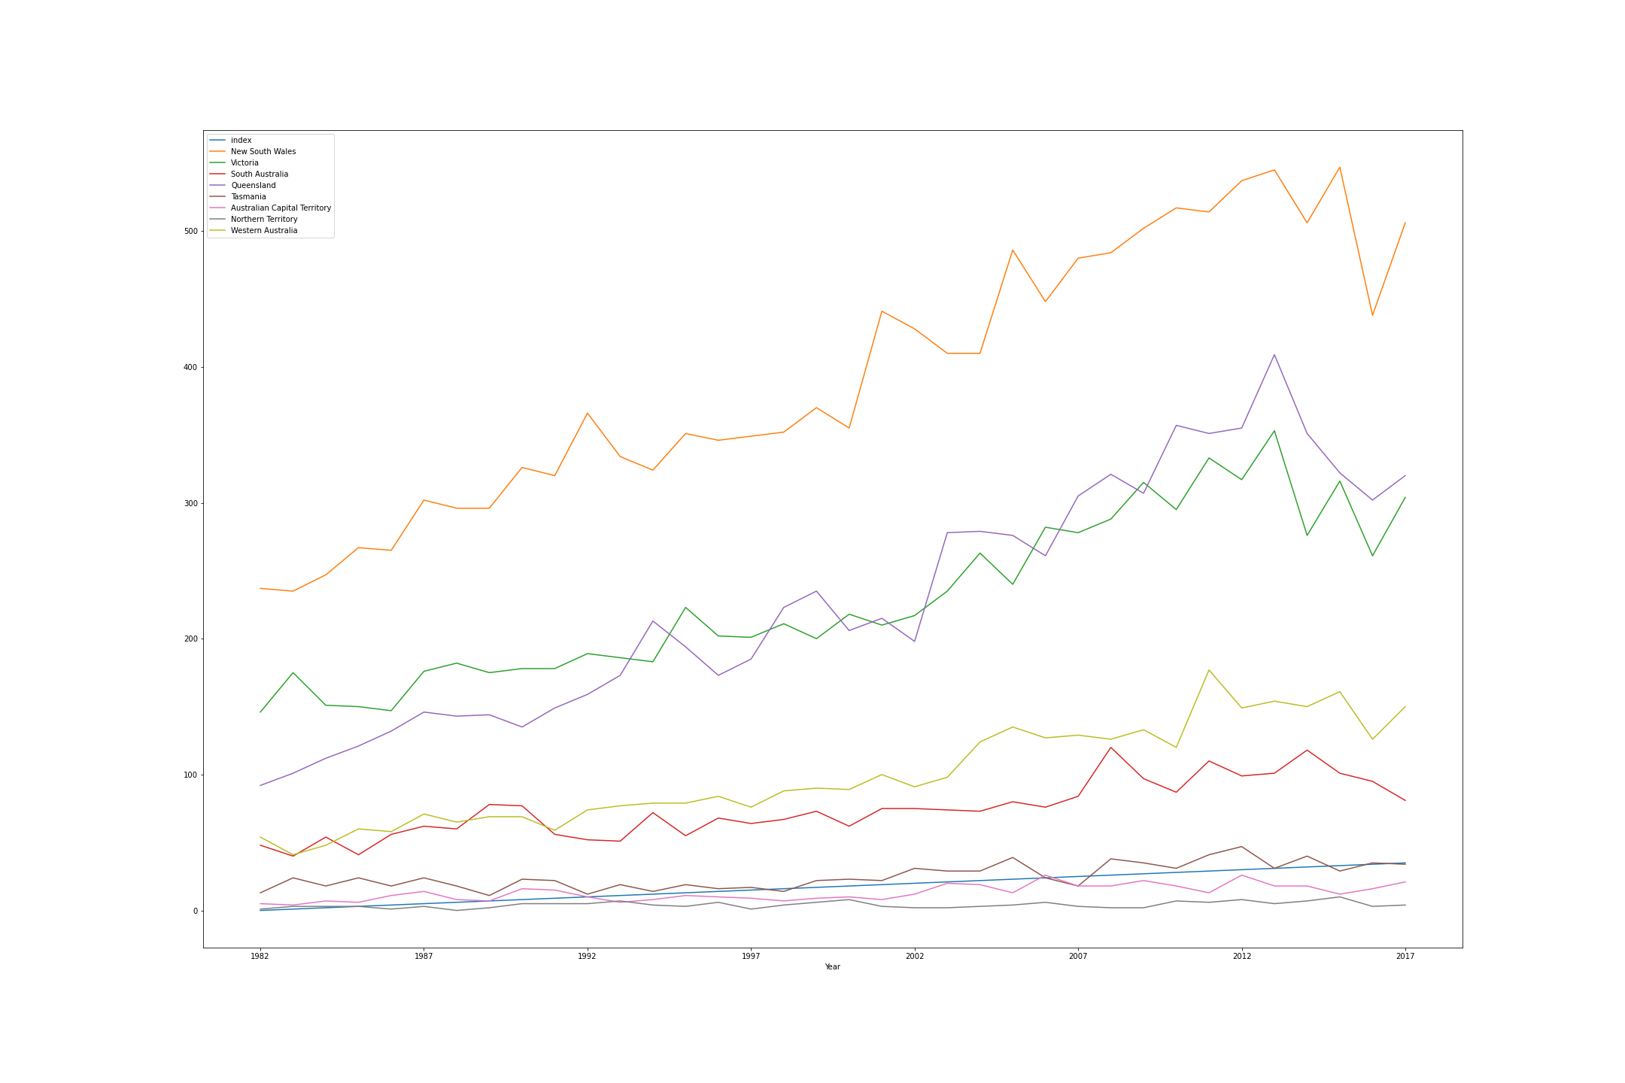
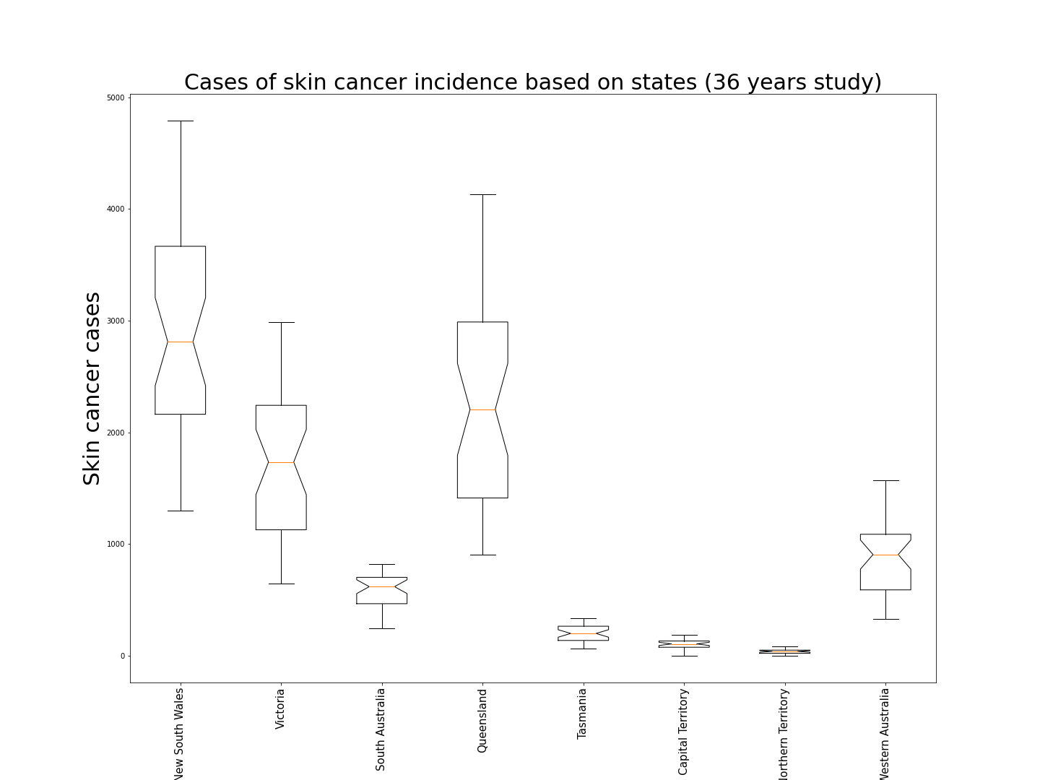

Slide 15
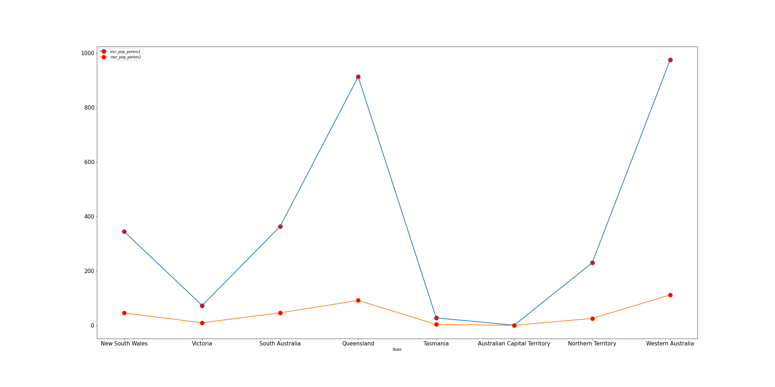
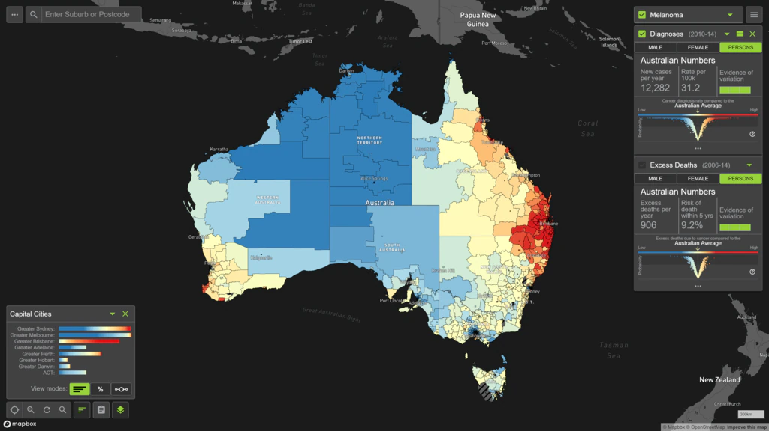

Slide 16
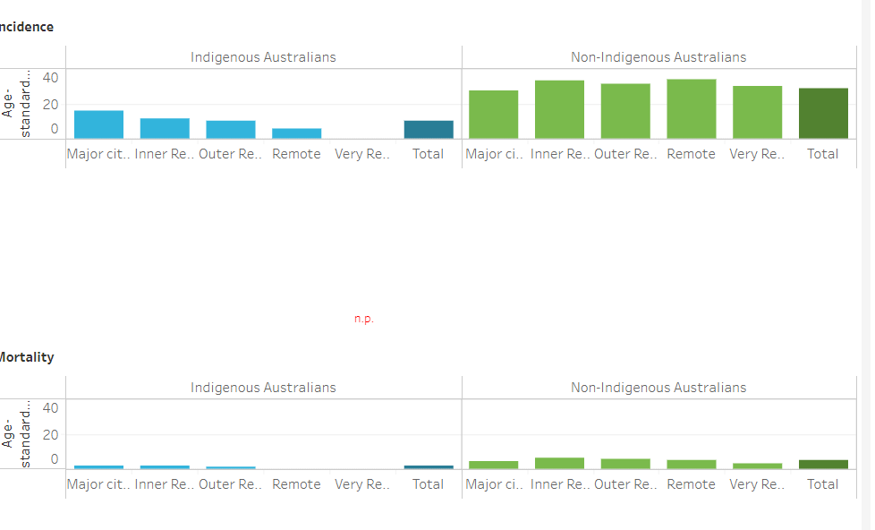
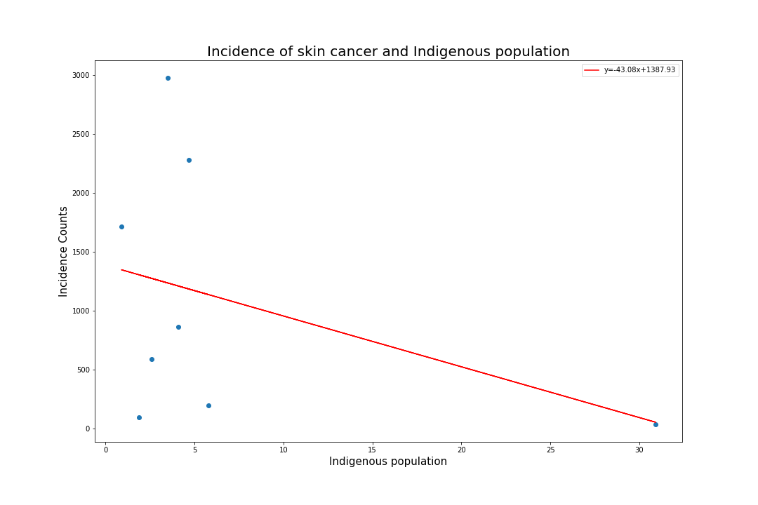
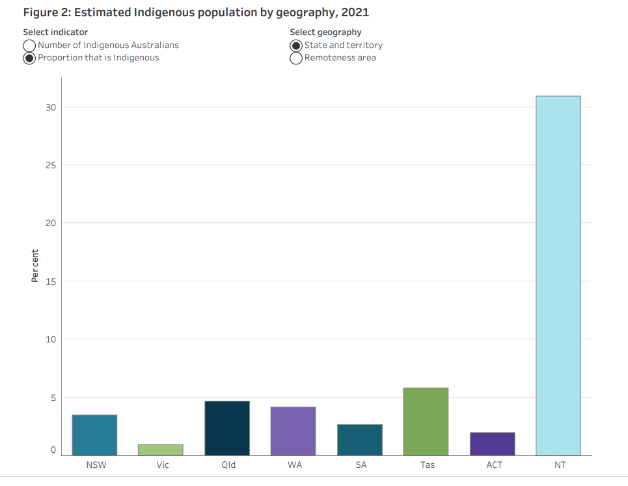
Skin cancer and ethnicity

Slide 17
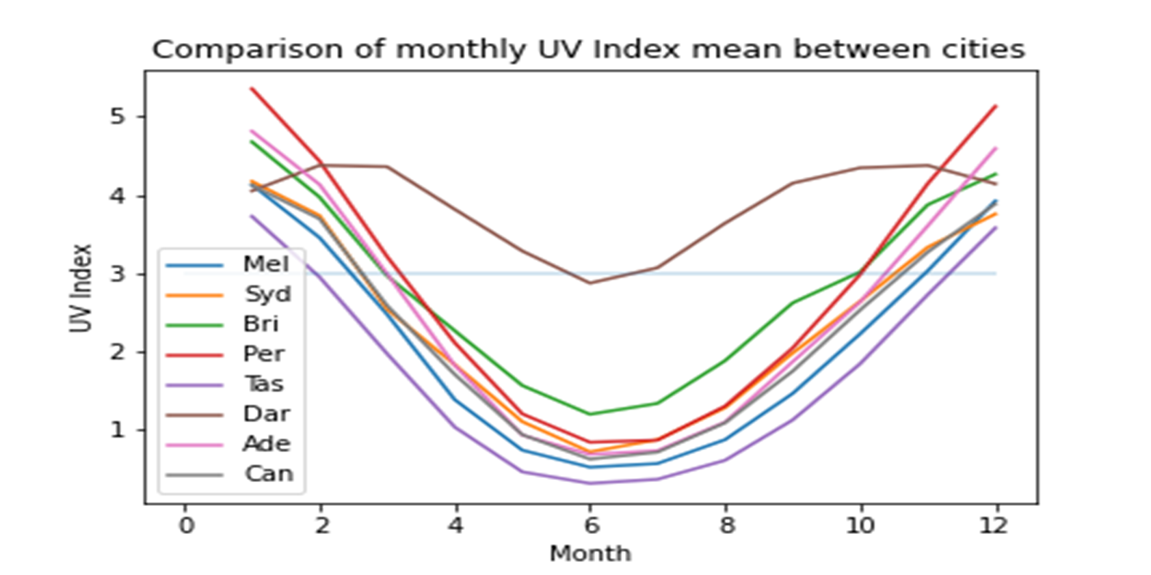
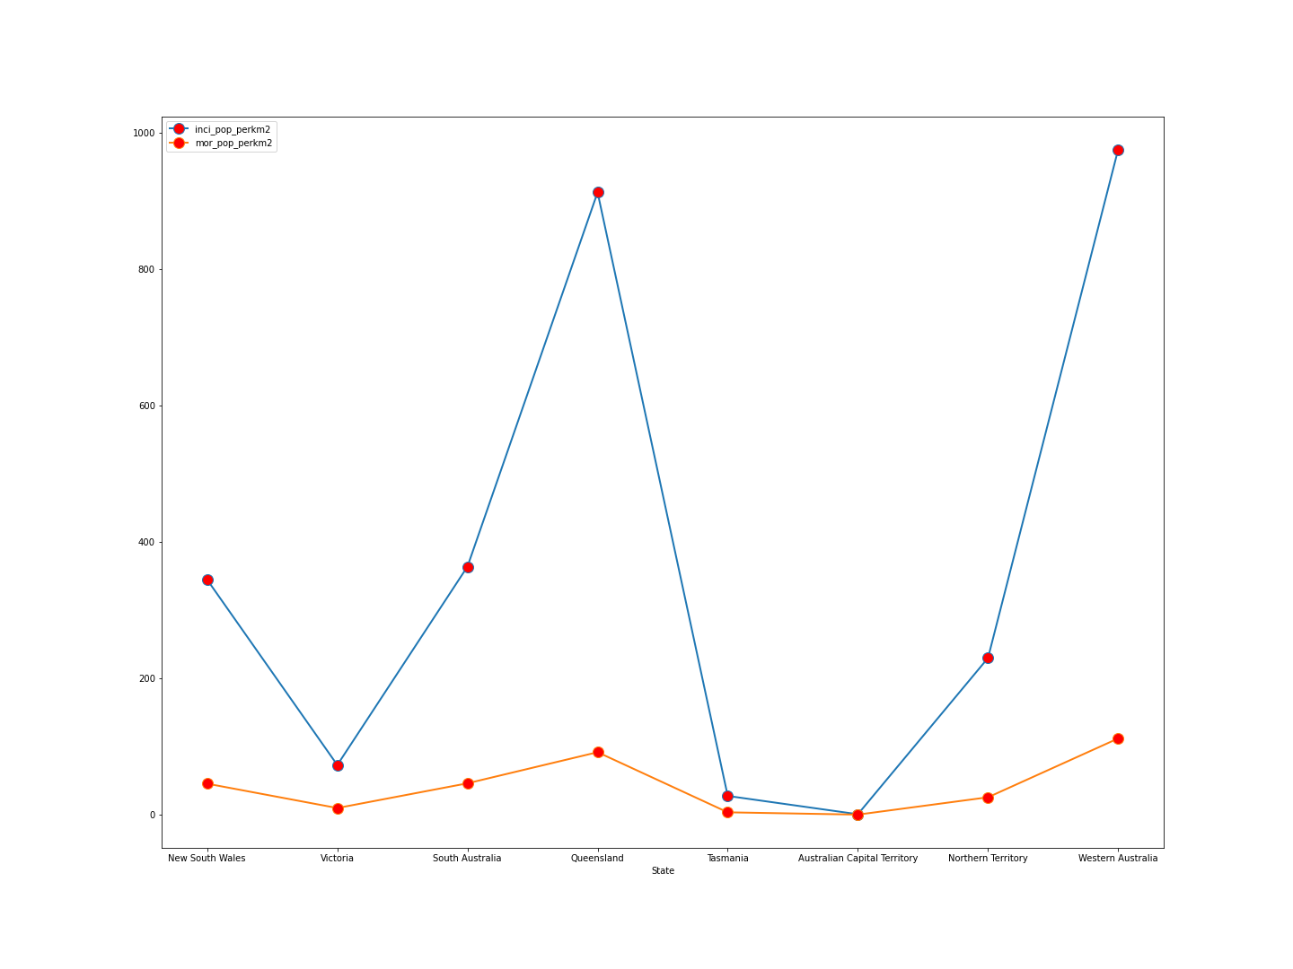
How does skin cancer compare to UV index?

Slide 18
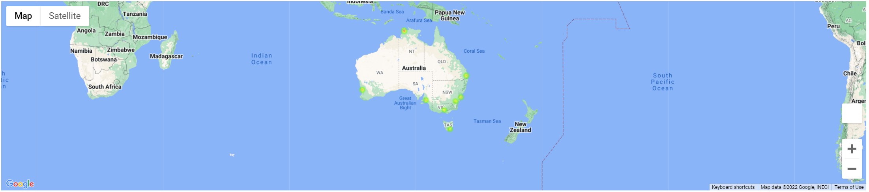
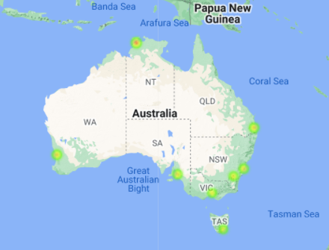
Australia major city Avg. UV index

Slide 19
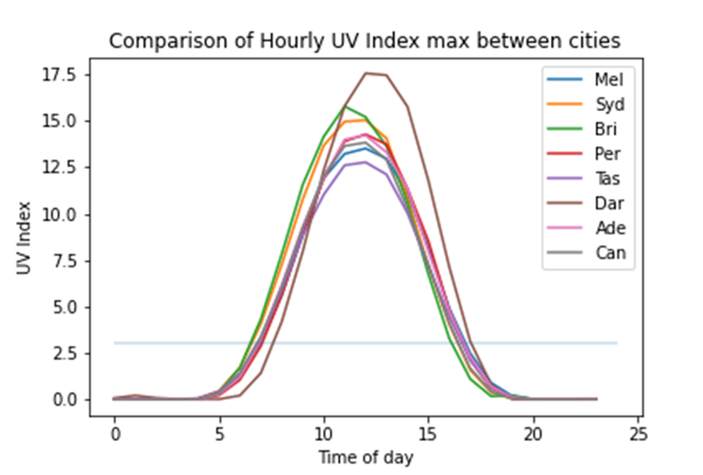
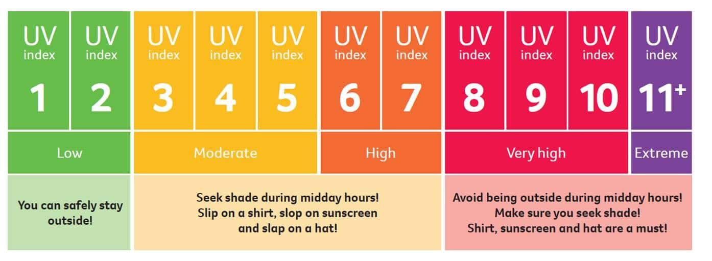
How does the UV index look during different times of the day?

Slide 20
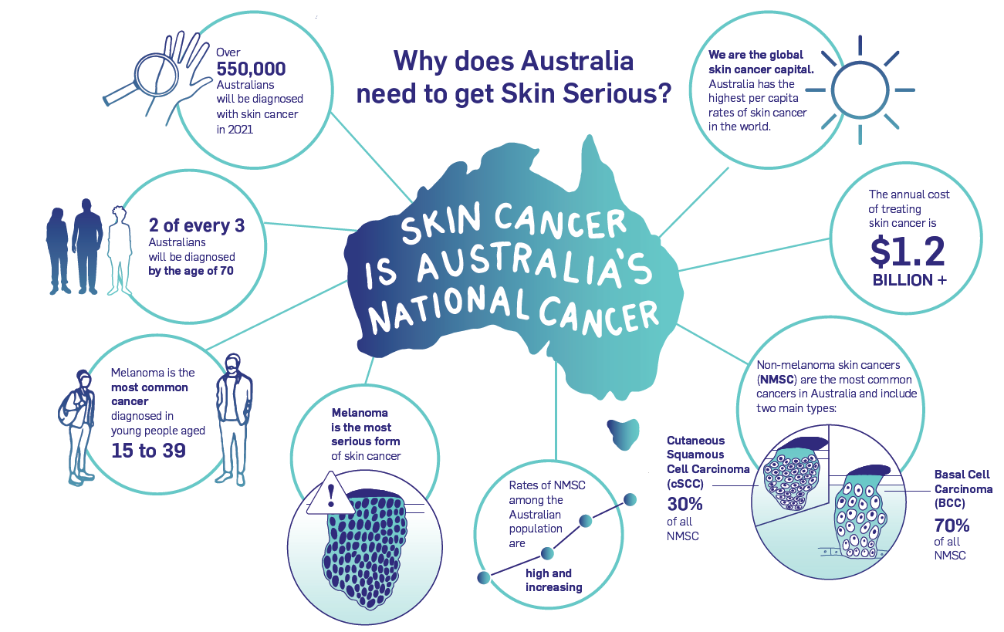
Findings & Conclusions
How serious is skin cancer in Australia?
Top deadly diseases in Australia
Australia is the skin cancer capital of the world
There’s been an upward trend in skin cancer cases since 1970
What’s being done to prevent it?
Budget of 2022-23
The Australian Government is investing $893.5 million over five years, from 2021–22 to 2025–26 on research of different cancer types and treatments
The annual cost of treating skin cancer is $1.2 billion.
Of this 90% is towards the risk factor ( high sun exposure)

Slide 21
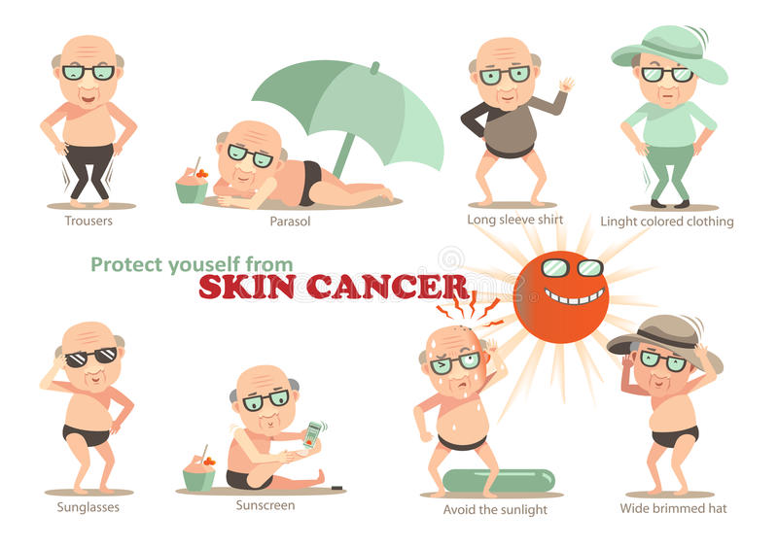
Is it preventable?
YES!
Being Sun Smart
Know the UV index
Slip, Slop, Slap. Seek and Slide
Use common sense!

Slide 22
Resources
https://www.myuv.com.au/
https://www.aihw.gov.au/reports/
data.gov.au
https://www.abs.gov.au/

